Slide 1
2024 INFORMATION DAY
COMPLIANCE REVIEW PRESENTATION
Robert Pitt

Slide 2
This Morning’s Presentation
Scope of Compliance Reviews
Why the Review
Key Compliance Findings
- The Good
- The Partial
- The Not so Good
Happy to receive questions throughout

Slide 3
SCOPE OF COMPLIANCE REVIEWS
Completed Cemetery Reviews for 7 Councils
Includes Legislative Compliance Checklist – 57 Criteria
Review + Assess Cemetery Records, Maps & Forms
Review Cemetery Policies and Procedures
Review Standard Letter Templates
Consult with Cemetery Staff & Cemetery Contractors
Consider with direct reference to legislation
Written Summary Report of the Findings
Recommendations to address non-complying items

Slide 4
Cemetery Documents & Forms Reviewed
Cemeteries Operating Policy
Application and Issuing of Interment Right (CCASA PES Form)
Renewal of Interment Right (CCASA PES Form)
Transfer of Interment Right Declaration (CCASA Form)
Interment/Burial Booking Form
Grave Digging Checklist Surrender of Unexercised Interment Right
Surrender of Unexercised Interment Right (CCASA has refund formula – Now capped at 30 Years)
Application for a Memorial (CCASA Form)
Lost Interment Right Declaration
Safe Work Method Statement Grave Digging (SWMS)
“Interment Right Renewal” letter
“Burials on Private Land Policy”
“Application for Burial on Private Land” form.

Slide 5
WHY REVIEW?
No Regulator or Regulatory Authority for cemeteries in S.A..
(Some States have e.g. NSW)
Crematorium requires EPA approval and an annual licence.
EPA require crematoria to report on cremations and respond to incidents of excessive emissions.

Slide 6
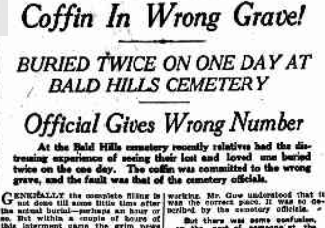
WHY REVIEW?
Non-Compliance Presents High Risks
Families and Loved Ones Distressed
Reputational Damage
Loss of Community & Customer Trust
Financial Consequences (Can be significant)
Logistical Remediation Costs
Compensation
Litigation
Insurance

Slide 7
KEY CEMETERY LEGISLATION (S.A.)
Burial and Cremation Act 2013 (SA)
Burial and Cremation Regulations 2014 (SA)
Enacted on 1 February 2014
Presented significant changes at that time
Now been in law for > 10 years

Slide 8
Other State Legislation to be Considered
Aboriginal Heritage Act 1988 - Crown Land Management Act 2009
- Development Act 1993 - Development Regulations 2008
- Environment Protection Act 1993 - Environment Protection Regulations 2009
Heritage Act 1993 (SA) - Heritage Places Regulations 2005
Local Government Act 1999 - Local Government (General) Regulations 2013
- Work Health Safety Act 2012 (SA) - Work Health Safety Regulations 2012

Slide 9
New Legislation Burial & Cremation (Interment Rights) Amendment Act 2023
Commenced on 23 February 2023
Created new offences:
For removing cremated remains without authorisation; and
For a relevant authority of a cemetery or natural burial ground’s failure to comply with obligations under interment right
Clarifying the legal status of interment rights & preventing future conflicts.
When debated, the question was raised whether there should be a central register or some other way for cemeteries and interment rights to be recorded on certificates of title.

Slide 10
New Legislation Burial & Cremation (Interment Rights) Amendment Act 2023
(1a) Subject to this Act, a person must not—
(a) remove cremated remains from an interment site in a cemetery or natural burial ground;
or
(b) re‑inter in a cemetery or natural burial ground cremated remains that have been removed from an interment site; or
(c) cause, suffer or permit an act referred to in paragraph (a) or (b),
While an interment right is in force in relation to the interment site unless authorised to do so by;
(d) the holder of the interment right; or
(e) if the holder of the interment right has died—a person referred to in section 35(1). (being the Personal representative = Executor, Administrator, or Entitled Relative)

Slide 11
New Legislation Burial & Cremation (Interment Rights) Amendment Act 2023
“Applies to the person or body for the time being responsible for the administration of the cemetery or natural burial ground regardless of when the interment right was issued, and regardless of whether the interment right was issued by that person or body or by some other person or body.”
“It is not a defence to a charge of an offence that the defendant was not aware of the existence of the interment right when the defendant assumed the administration of the cemetery or natural burial ground unless the defendant proves that the defendant took reasonable steps to identify interment rights in existence at the time that the defendant assumed the administration of the cemetery or natural burial ground.”

Slide 12
SCOPE OF COMPLIANCE REVIEWS
The Cemetery Compliance Checklist has 57 Criteria
Overall High Level of Compliance
On Average:
85% Full Compliance
7% Partial Compliance
8% Non-Compliance

Slide 13
Common Areas of Compliance
Use of term and issuing of “Interment Rights” (not lease, licence or grant)
Register of Interments (1 of 3 Mandated Registers, s53 of Act, Reg 36)
Issuing of Plain English Statements (“PES” for new, renewed and transferred interment rights)
Requirements of an interment right are detailed in s30(1) of the Burial & Cremation Act 2013.
Include the Terms and Conditions of the interment right. (Usually on back of IR)
Cemetery Plans - Robust and well maintained – core source documents
Must stipulate the tenure of the IR – 25, 50, 99 years or “in perpetuity”.

Slide 14
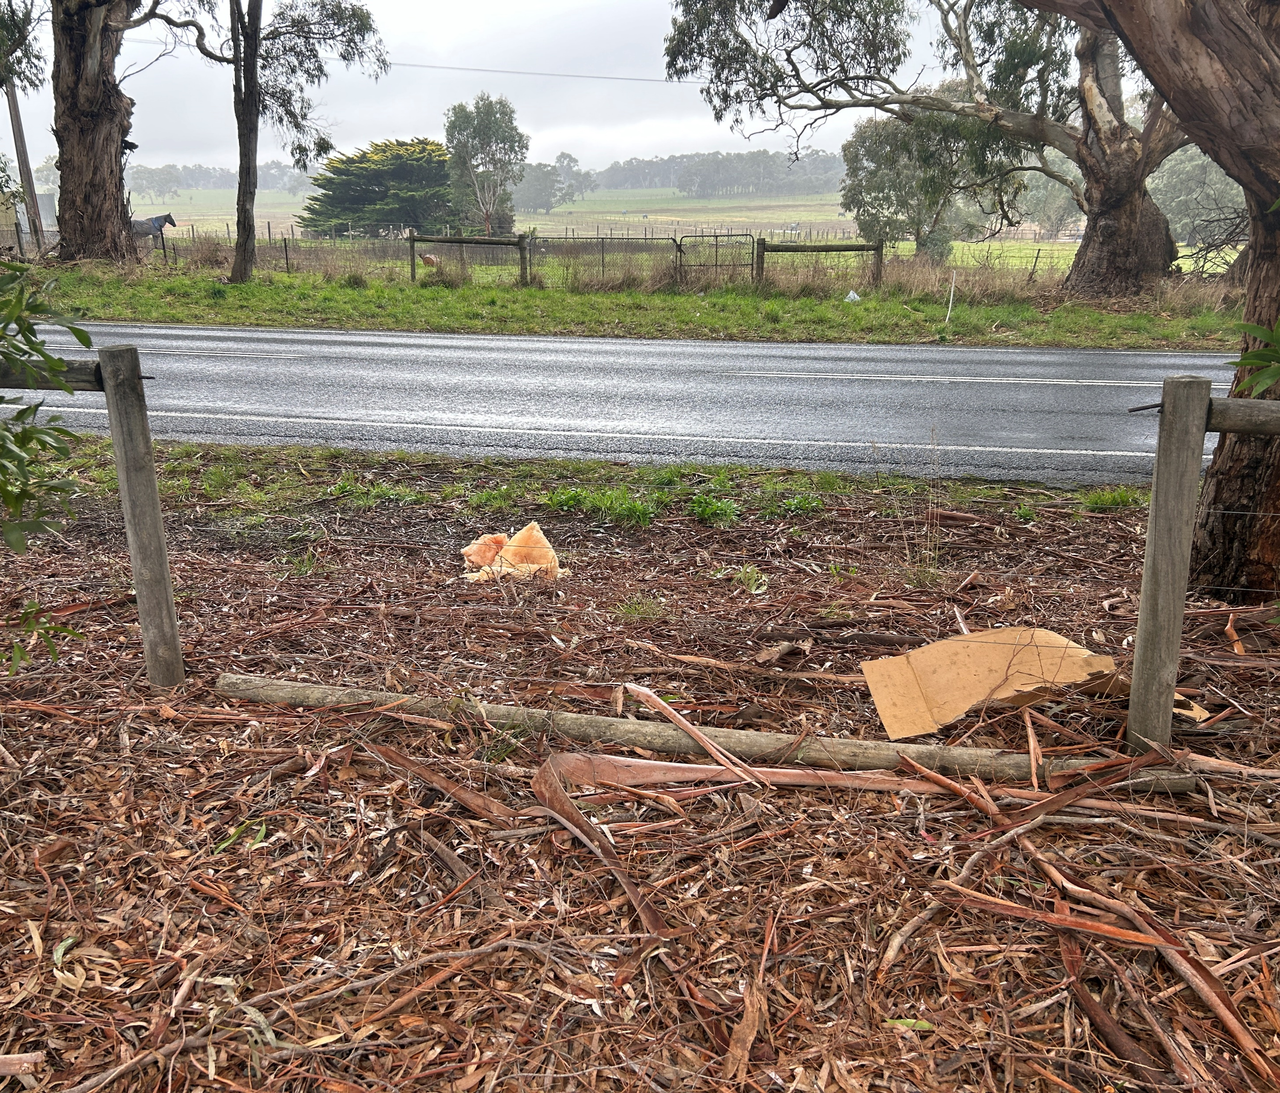
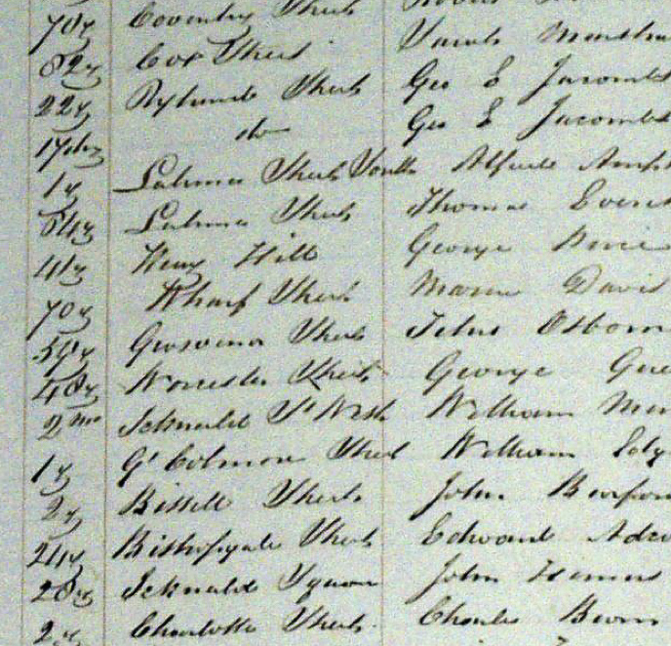
COMMON AREAS OF PARTIAL-COMPLIANCE
Register of Interment Rights
2nd of 3 mandated Registers
(s37, s53, of the Act & Regulation 36)
Often missing information
Legacy issues re historical records, lost, incomplete
Usually pre-1945, almost always pre-1910
Genealogy SA is a good resource
Regulation 22: Cemeteries to be fenced
“The relevant authority for a cemetery or natural burial ground must ensure that the cemetery or natural burial ground is securely fenced at all times.”
For Councils: Some cemeteries have been found to have Community Land Management Plans, others don’t, but probably should. (LGA Act 1999)

Slide 15
THE 6 COMMON AREAS OF NON-COMPLIANCE
No. 1: Not notifying IR holders of impending expiry of IR
32—Renewal of interment rights
(1) A relevant authority must, on application by the holder of an interment right and payment of the renewal fee fixed by the relevant authority, renew the interment right for a period of not less than 5 years.
(2) Subject to the regulations, a relevant authority must, at least 12 months before an interment right issued by the relevant authority is due to expire, take reasonable steps to give the holder of the interment right a written notice in a form approved by the Minister—
(a) setting out the holder's entitlement to renew the interment right; and
(b)informing the holder that if the interment right is not renewed and there is a memorial to the deceased in the cemetery or natural burial ground, the memorial may be reclaimed from the relevant authority; and
(c) informing the holder of prescribed matters.

Slide 16
Not Notifying IR holders of Impending Expiry of Interment Right Missed Opportunities
By failing to comply with this requirement, cemetery authorities are:
1/ Denying families and loved ones the opportunity to have further interments and/or memorial on an interment site.
2/ Missing the opportunity to obtain updated contact details for interment sites.
3/ Missing out on potential interment right renewal/extension revenue.
And ….when an IR expires, ownership of the interment right reverts to the cemetery authority. By default, they then own, and are responsible for the monument, headstone, or memorial.

Slide 17
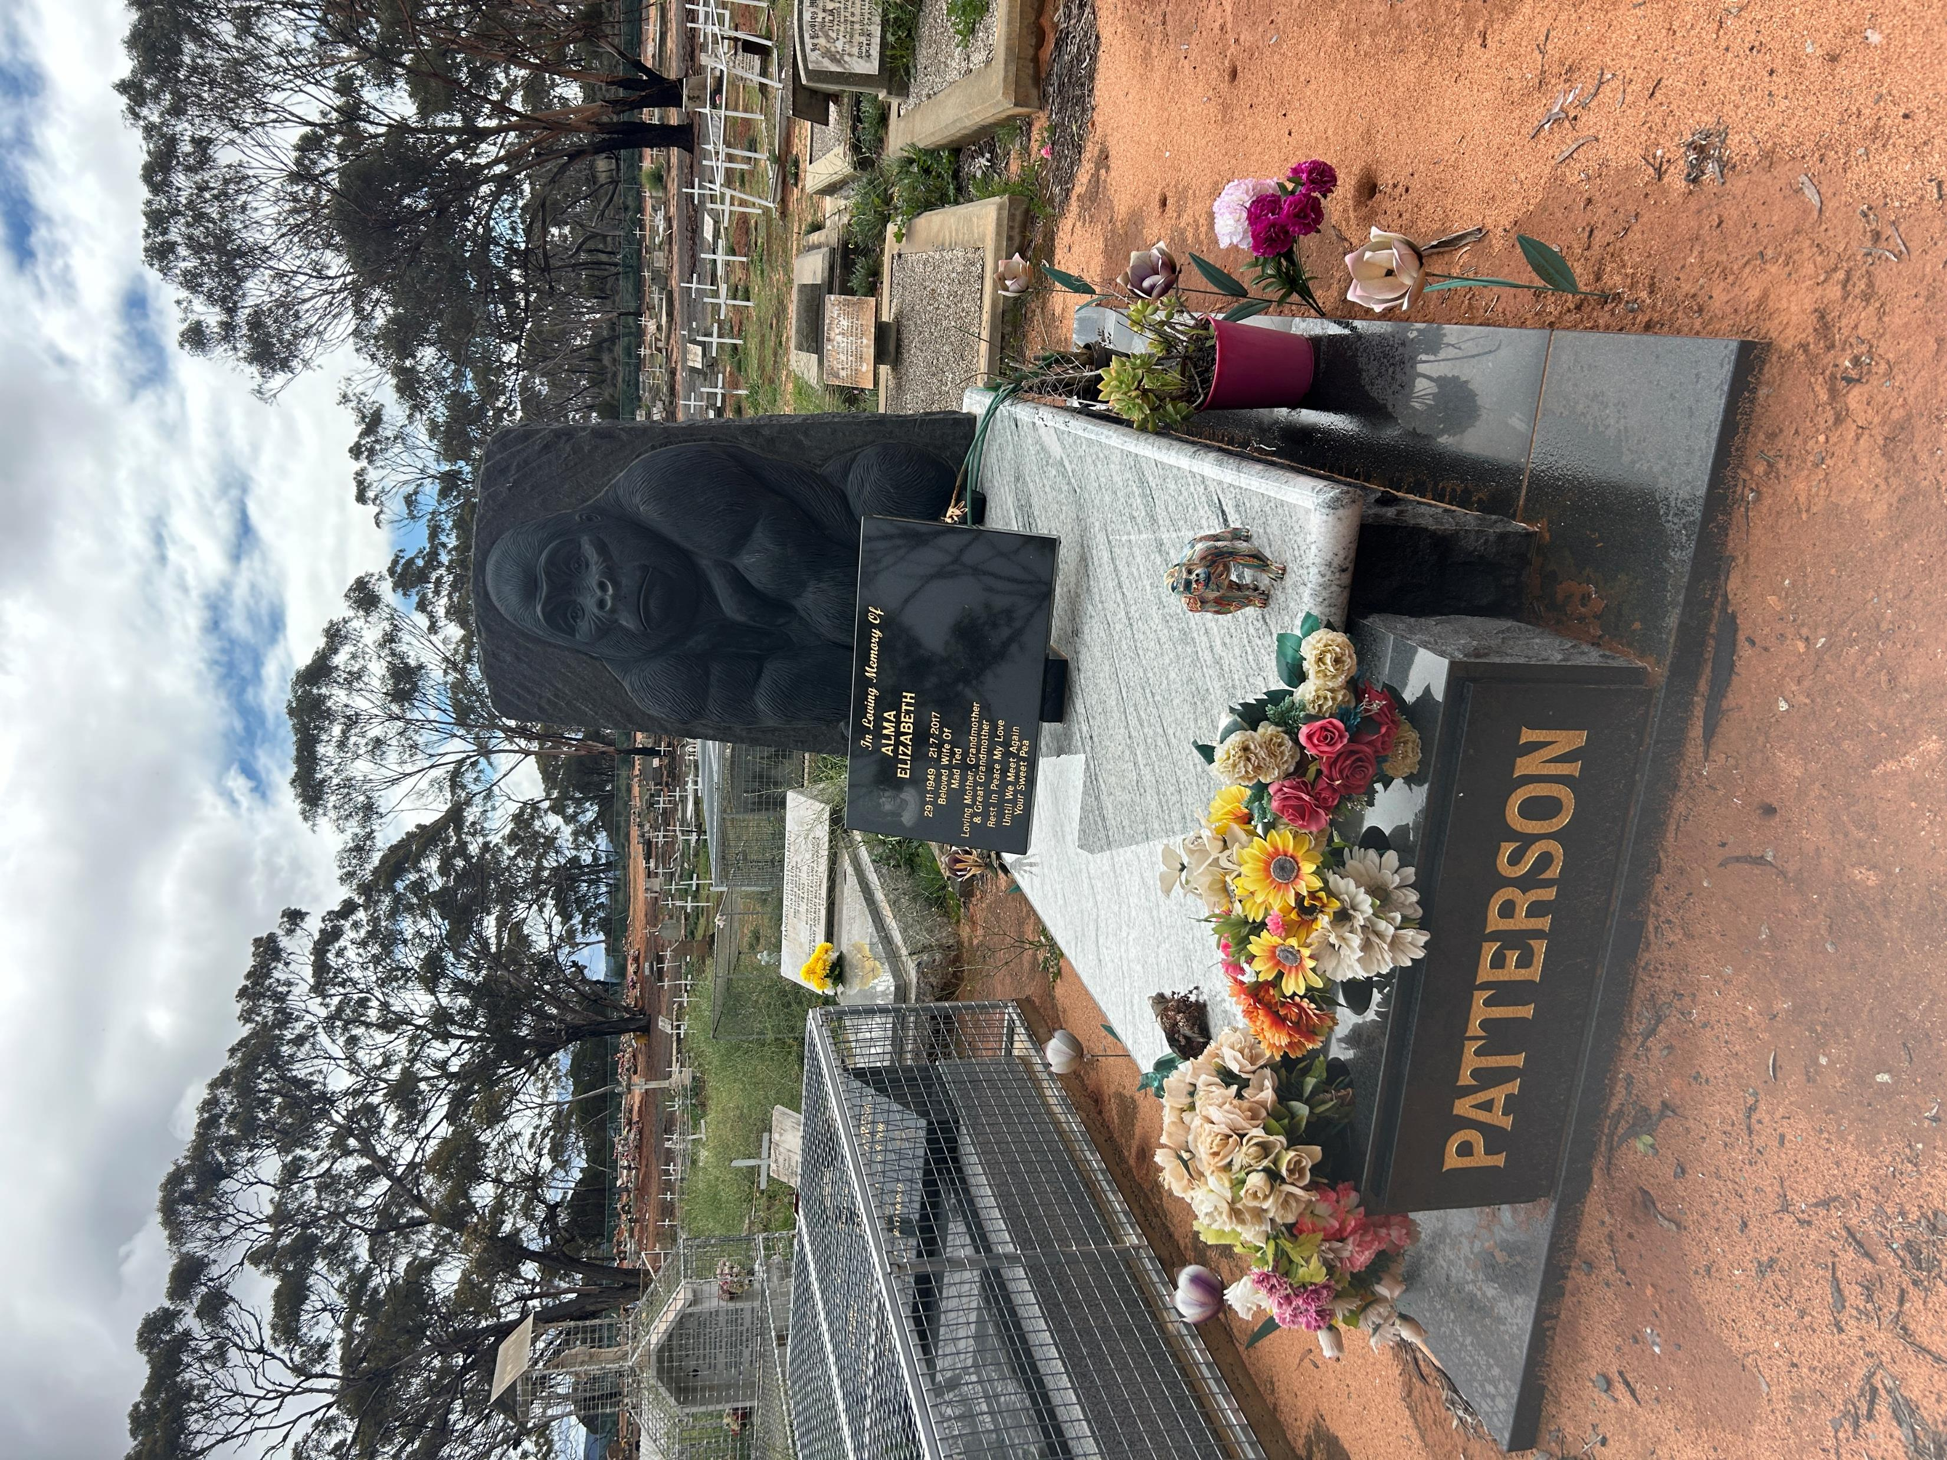
No. 2: No Memorials Register (3rd of 3 Registers)
Regulation 36(2)
“A register under section 53(1)(b)(ii) of the Act
must include the following particulars in relation
to each memorial erected in a cemetery:
the size of the memorial;
the type of memorial;
the name or names inscribed on the memorial;
any epitaphs and other inscriptions on the memorial;
the location of the memorial in the cemetery.”

Slide 18
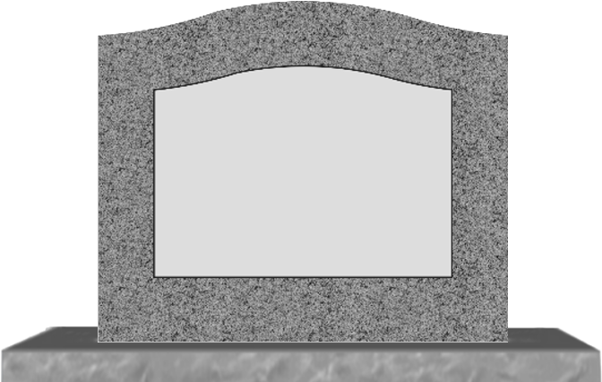
No. 3: No Records of Pre-Need/Pre-Paid Site Sales
Nearly all audits have been unable to identify “pre-paid” or “pre-need” interment sites, interment rights or ashes memorial sites.

Slide 19
Creates risk of errors.
Record pre-paid /pre-need sites that are purchased.
Must be issued with an Interment Right.

Slide 20
No.4 MANAGEMENT OF CEMETERY RECORDS
Cemetery records must be managed in accordance with the State Records Act 1997 (SA).
General Disposal Schedule 41 (GDS 41) for burial and cremation records
(Dec 2020).
State Records classify the majority of burial and cremation records as “permanent records,” meaning these are required to be retained forever.
Exclusions are mainly invoices and internal burial booking forms.

Slide 21
No. 5: Cemetery WHS (1)
Masons and contracted grave diggers to provide annually to cemetery authorities, copies of:
Public Liability Cover (preferably $20M)
WorkCover currency,
Plant Operating Licences
Crane Inspections
WHS Policies; and
Safe Work Procedures,
It is recommended that Cemetery Authorities annually contact monumental masons and contracted grave diggers who work in their cemeteries and request they provide this documentation to Council. The documents should be retained on the cemetery’s records/files

Slide 22
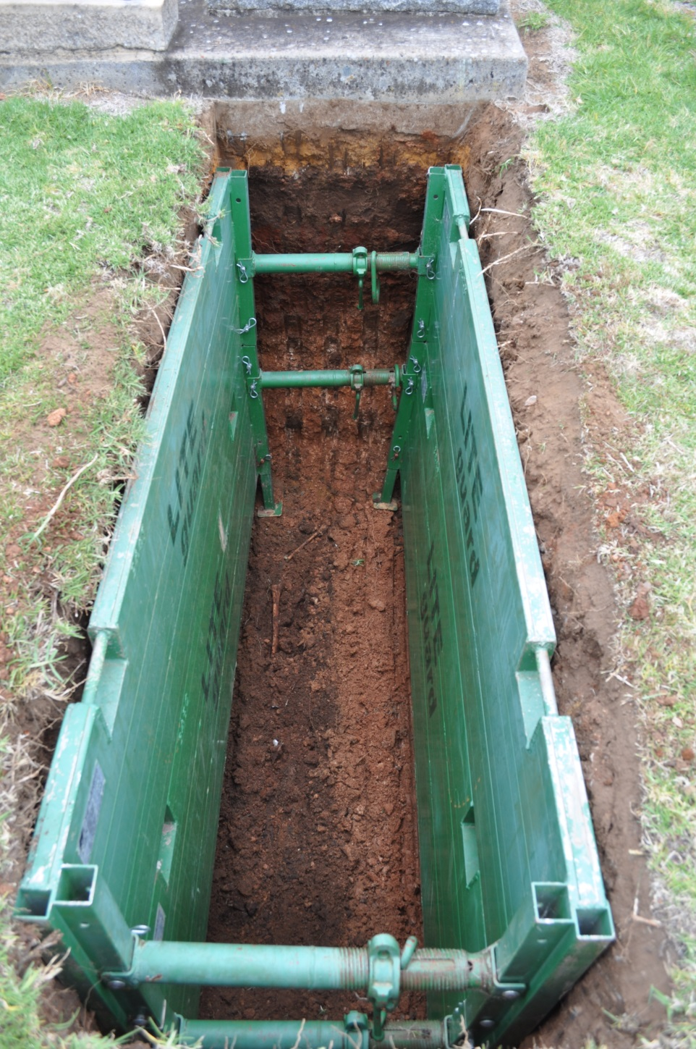
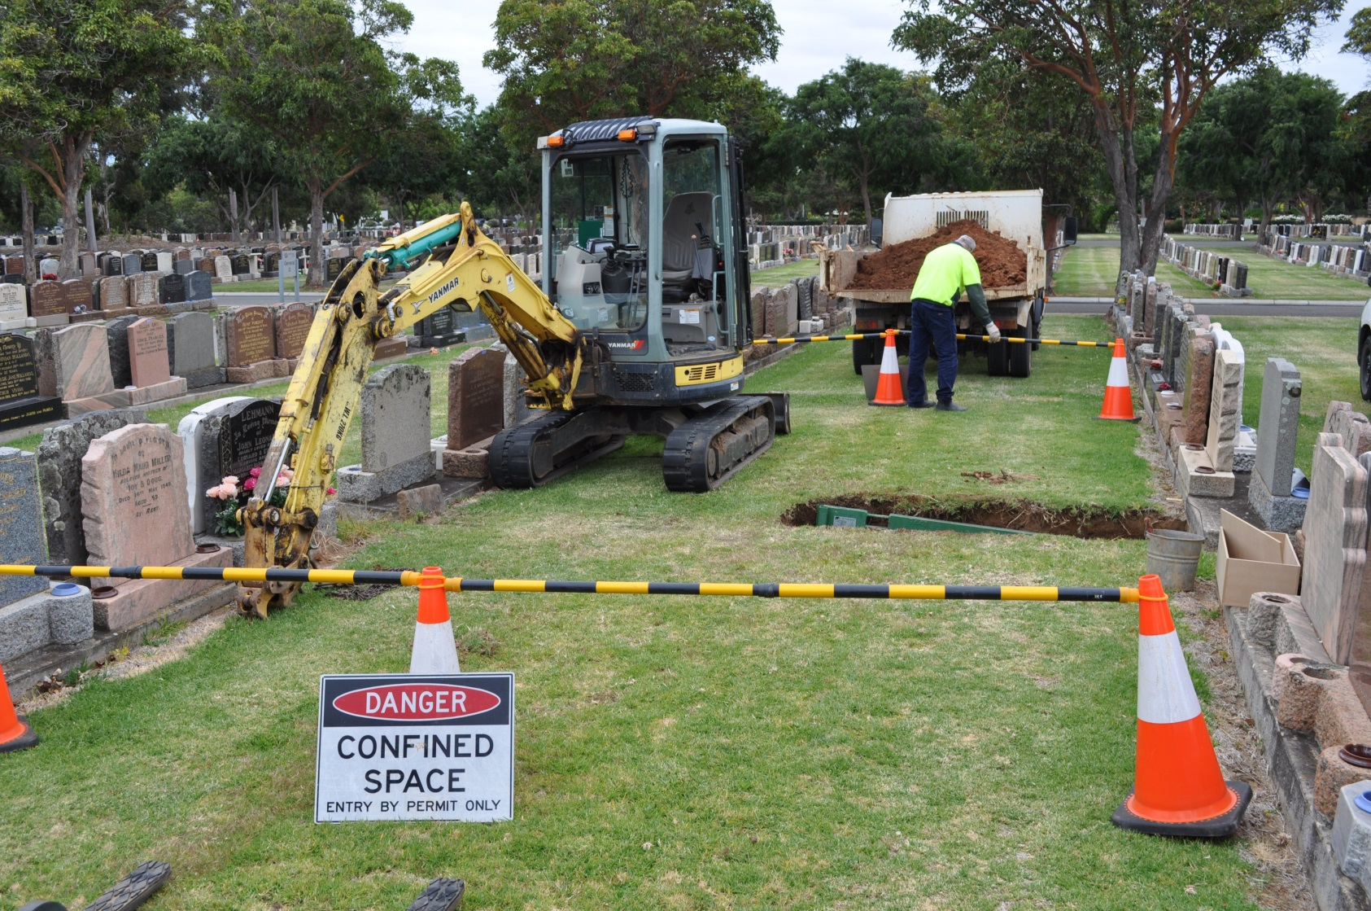
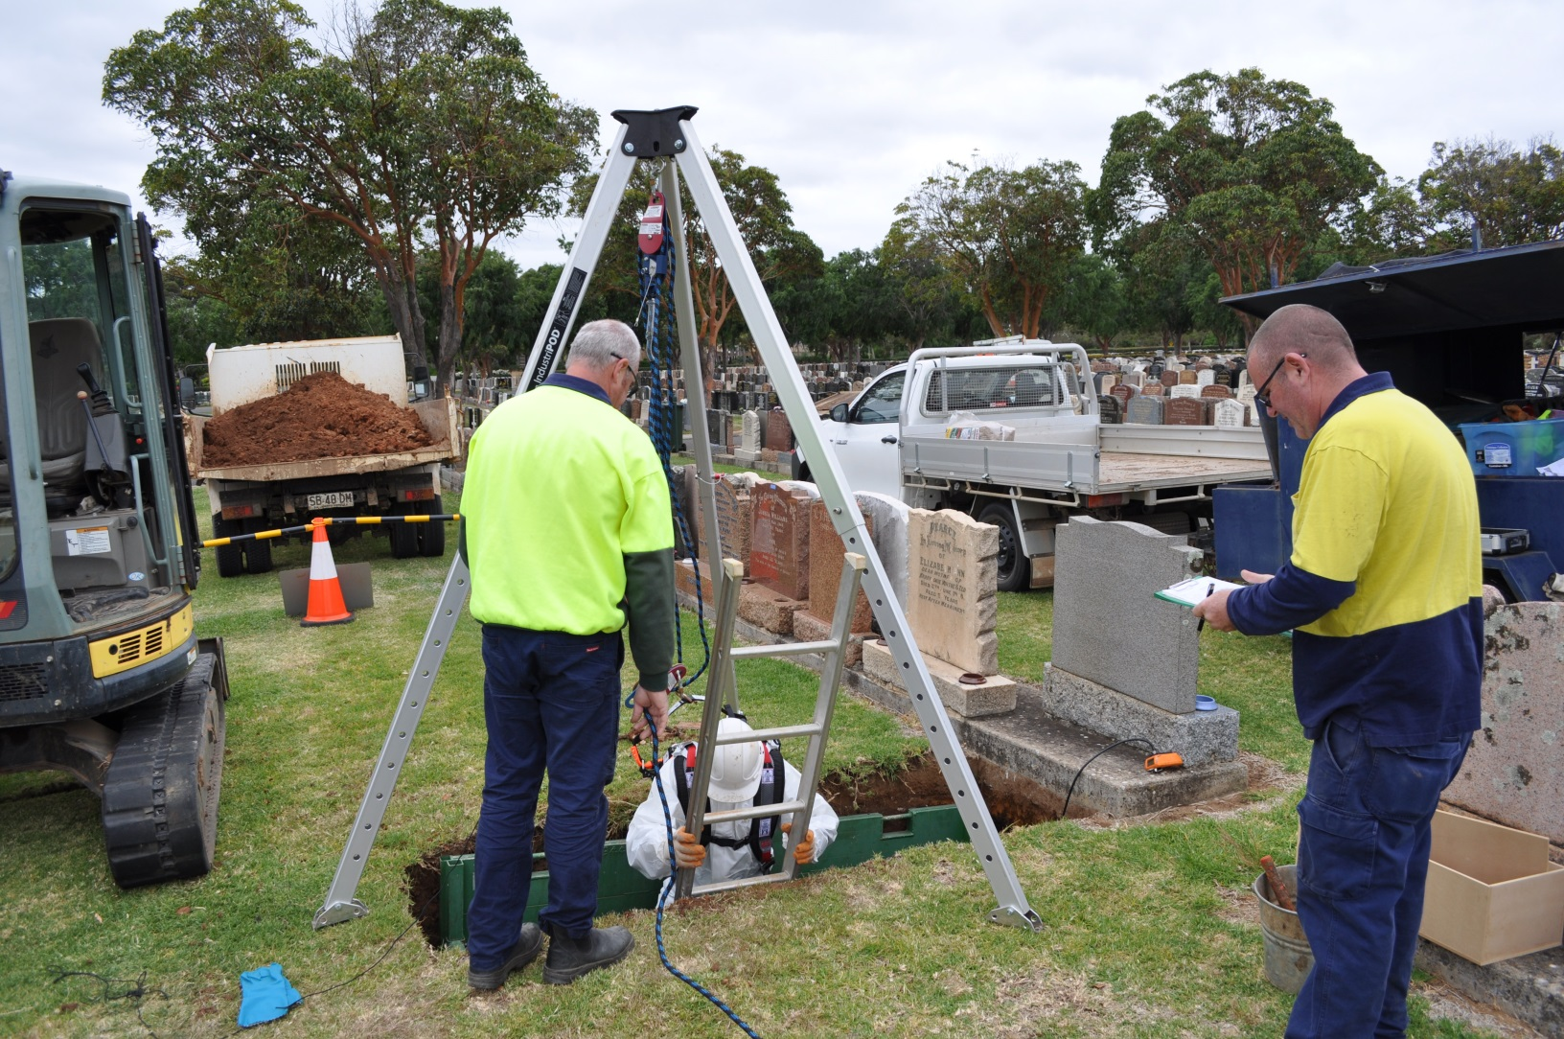
No. 6: Cemetery WHS (2)
Graves are defined as “Confined Spaces.” As such, persons going into a grave must have Confined Spaces Entry Permit & a Confined Spaces Work Certificate.
The grave must be shored up before anyone descends into it.
Shoring varies greatly . “Homemade” – effective maybe but non-complying.

Slide 23
SA Office of Births, Deaths & Marriages Deaths for the Period July 2023 to June 2024
REGISTRATIONS | 2023/24 | % CHANGE | 2022/23 | 2021/22 | 2020/21
Annual Deaths | 15,270 | -4.3% | 15,949 | 15,009 | 13,804
Burial | 3,869 | -5.0% | 4,071 | 4,139 | 3,778
Cremation | 11,240 | -3.9% | 11,696 | 10,687 | 9,874
Other* | 163 | -24.5% | 203 | 185 | 159
*Other denotes Mausoleum Interment, University Bequeath, or Interstate Transfer

Slide 24
State Deaths, Burials & Cremations 2012-2024

Slide 25
THANK YOU
QUESTIONS

