Slide 1
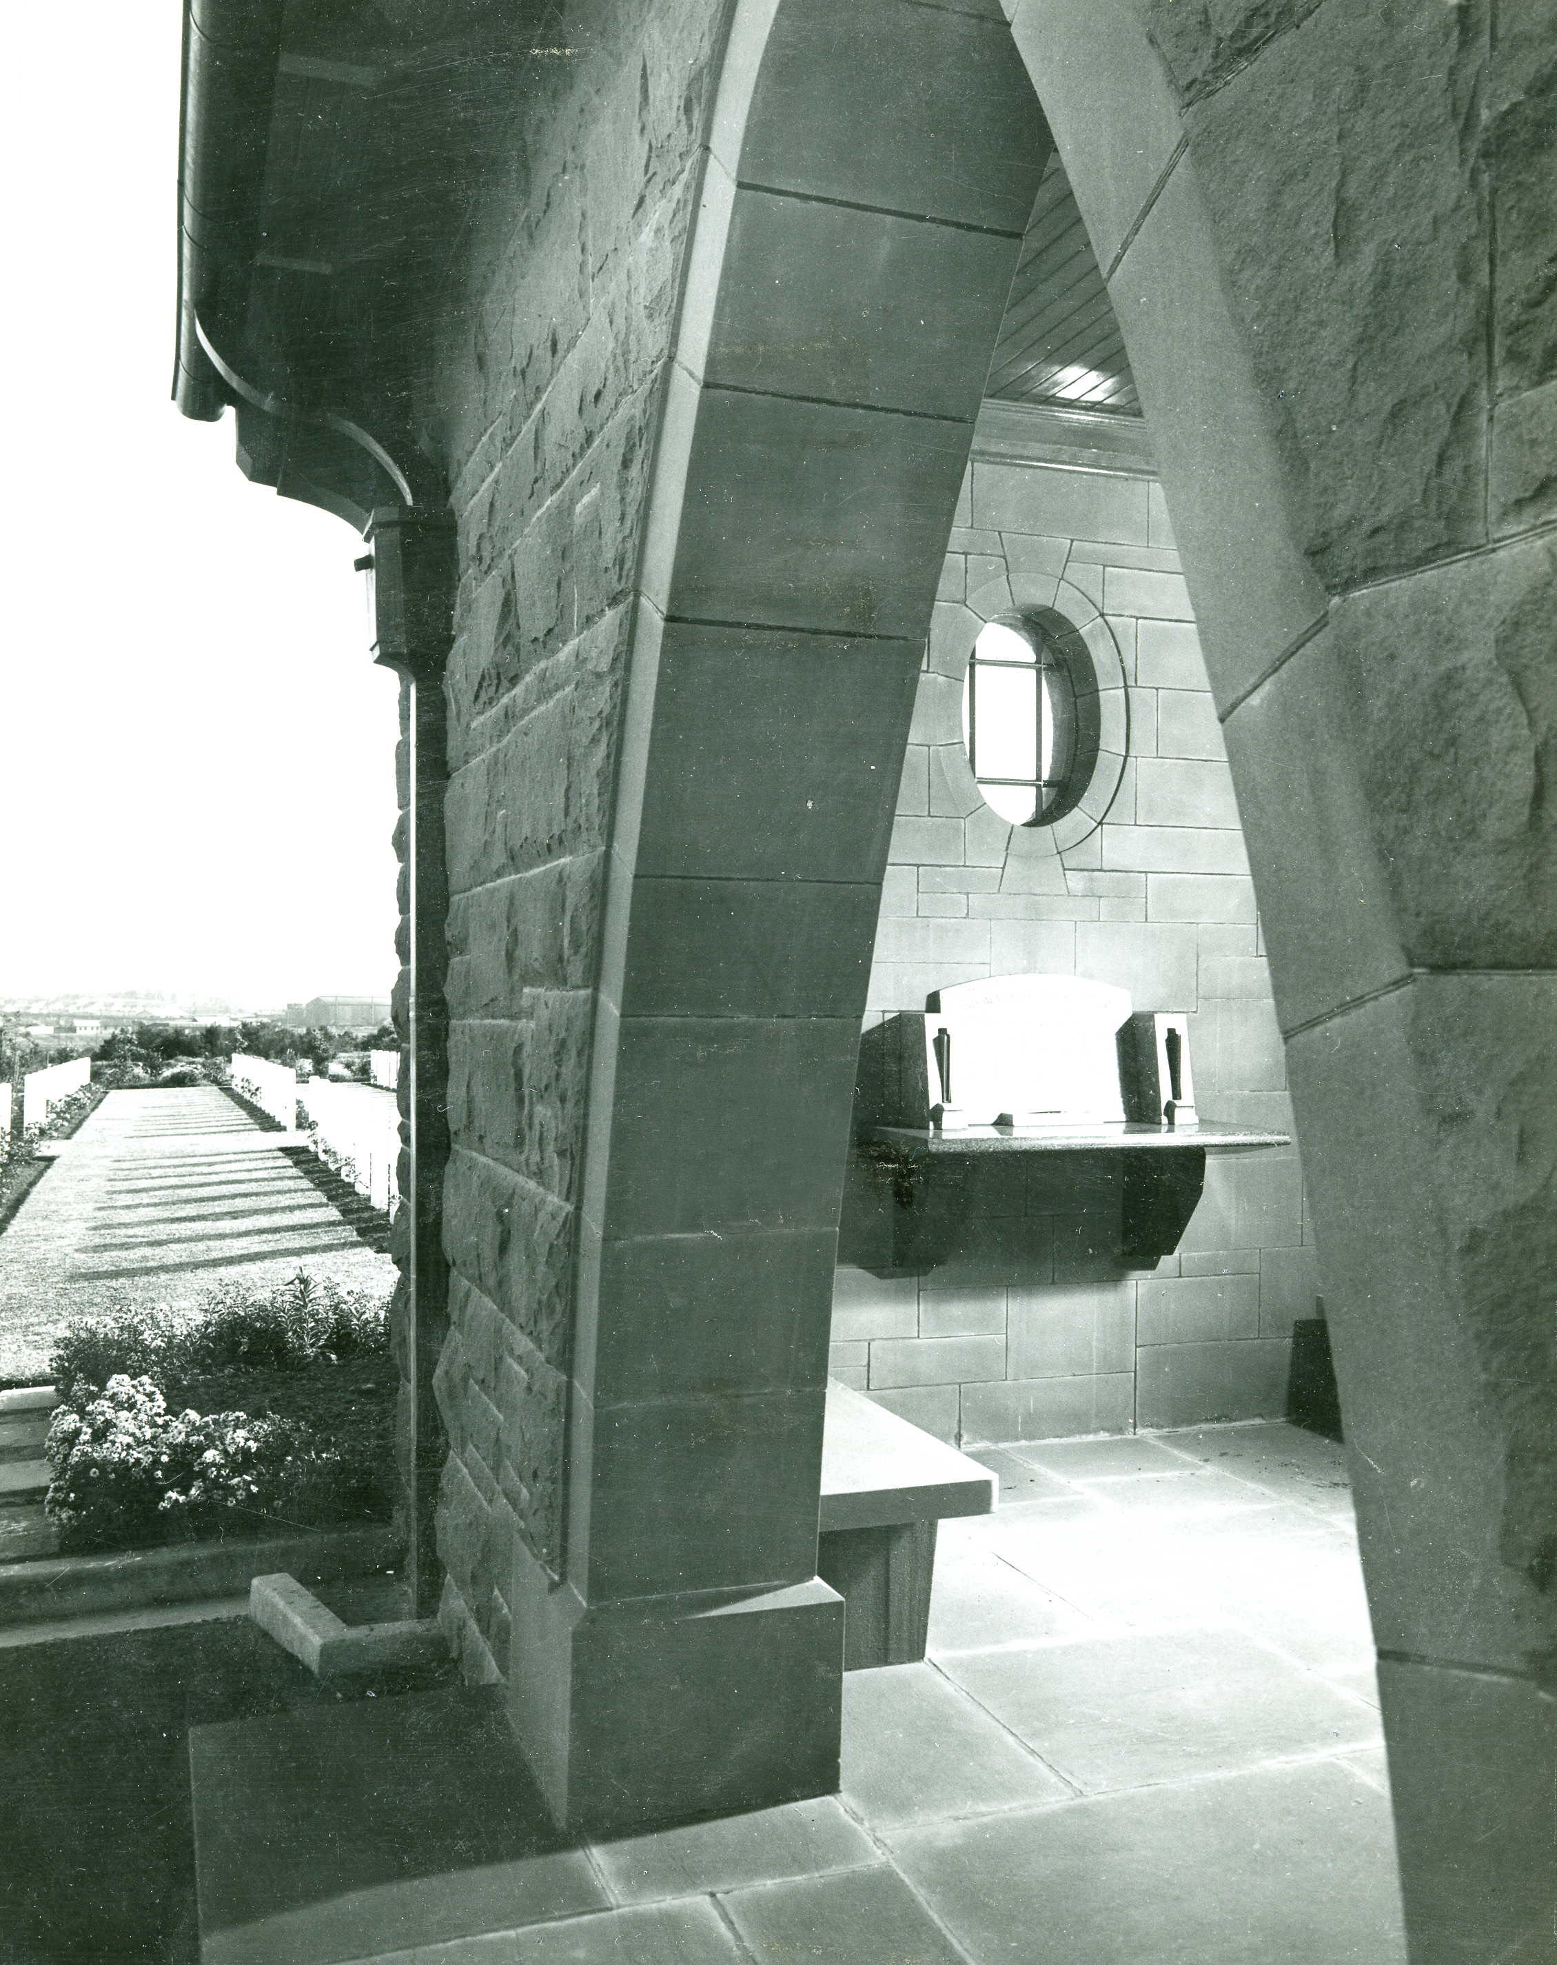
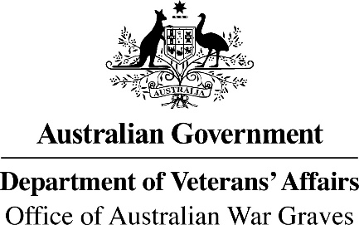

Insights & Understandings

Slide 2
Acknowledgements
The Office of Australian War Graves acknowledges the Custodians of the lands and waters ways where the war and post war dead of our nation are at rest.
We recognise the continuing responsibilities Custodians have to care for country at these sites of commemoration and remembrance. We pay our respects to Elders past, present and emerging and extend those respects to all Aboriginal and Torres Strait Islander First Nation Peoples.
On behalf of my colleagues, I respectfully acknowledge the Kaurna miyurna. It is a privilege to be in your country again, and I thank you for your welcome.
I acknowledge also those amongst us who have served their nation in uniform.
Thank you for your generosity and your service.

Slide 3
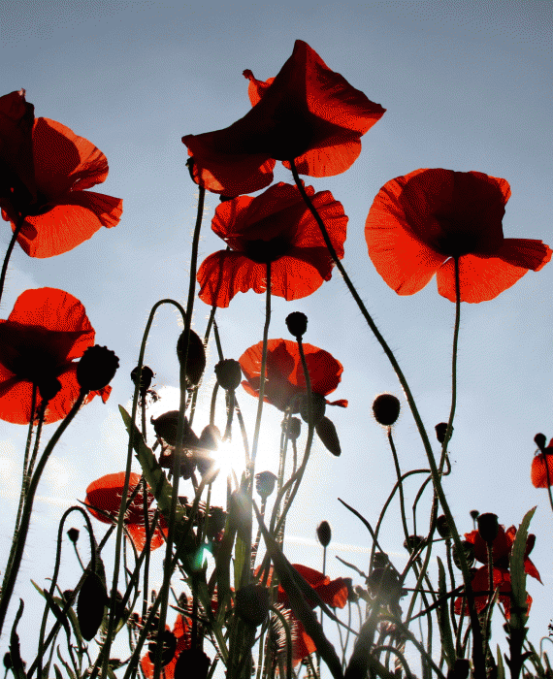
They shall not grow old,
As we that are left grow old:
Age shall not weary them,
Nor the years condemn.
At the going down of the sun
And in the morning
We will remember them.
Laurence Binyon (1869-1943)

Slide 4


Slide 5
More than 2 million Australians have served their nation in uniform.
More than 103,000 of them have died
in war. 13,000 are at rest within a War Cemetery in Australia.
They are all war dead.
326,465 have died after a war, bit of
causes attributable to their war service.
They are our post war dead.

Slide 6



Slide 7
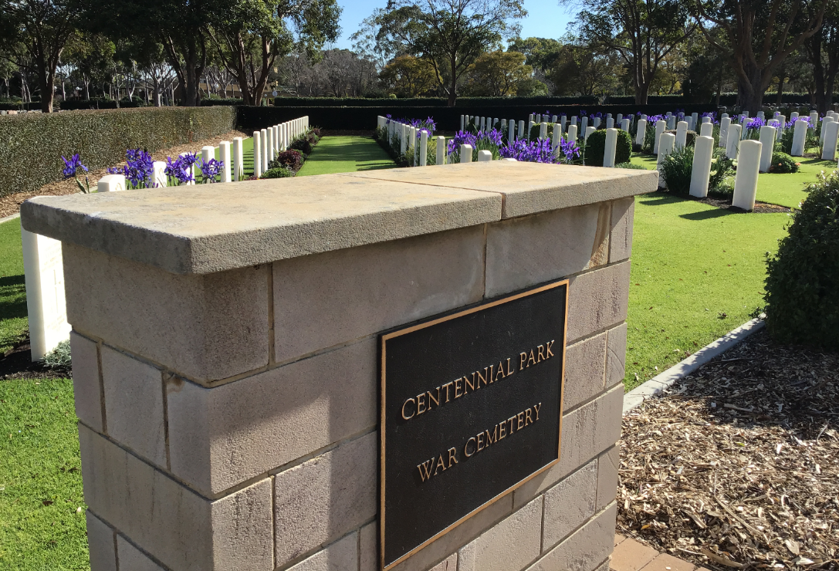
Centennial Park War Cemetery

Slide 8
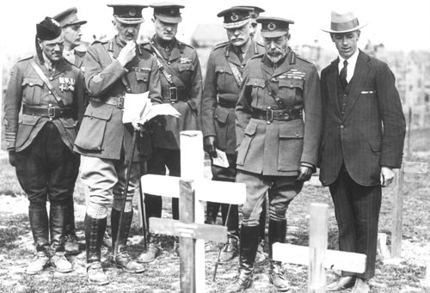
Papua New Guinea – Bomana War Cemetery
King George V and Sir Fabian Ware

Slide 9
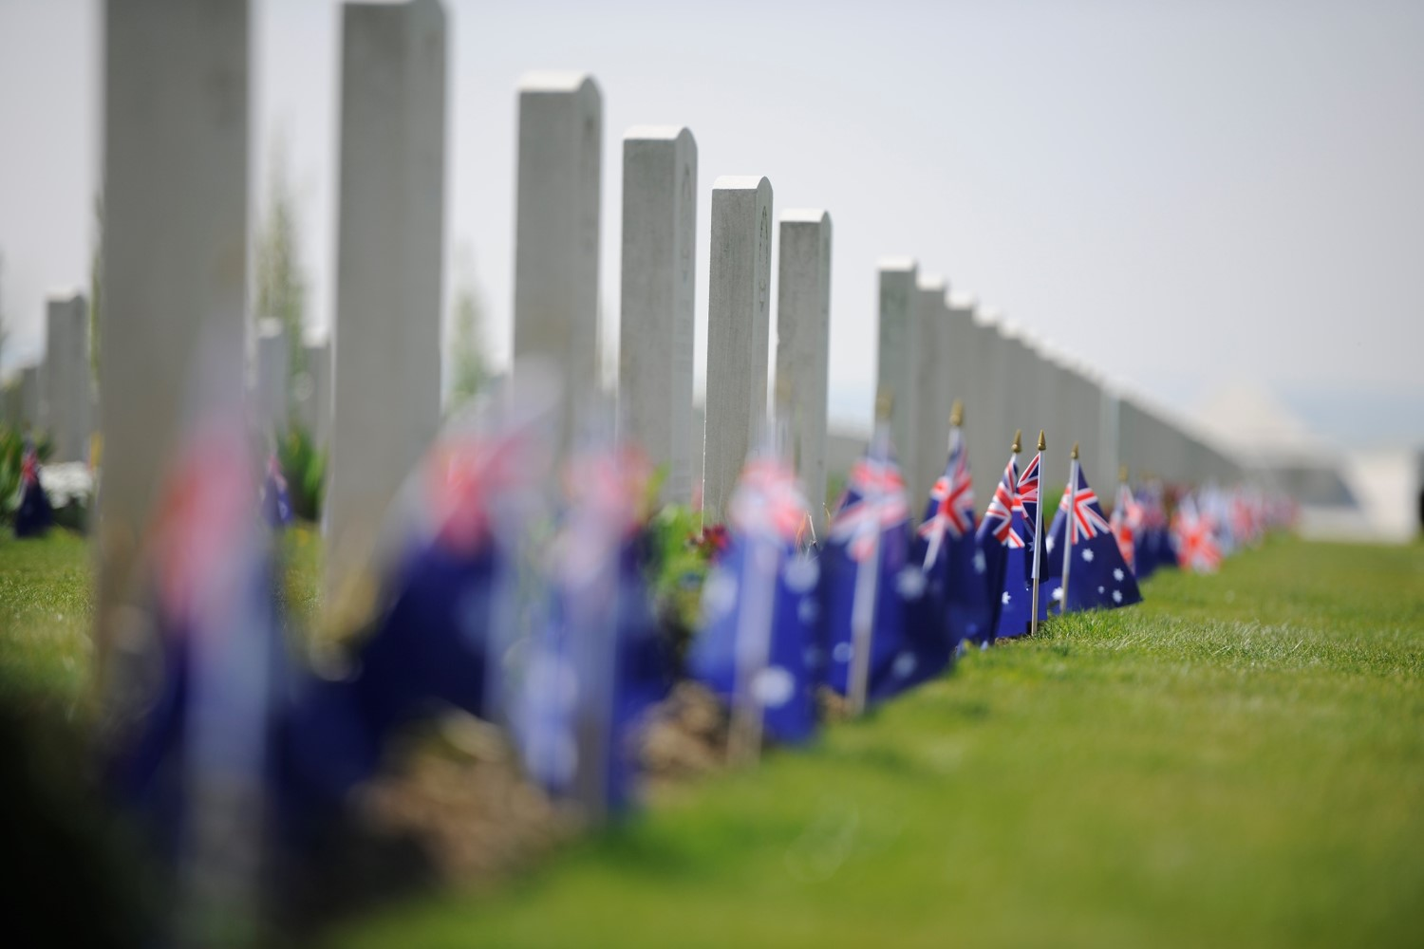
587,000 graves
559,000 casualties
with no known grave

Slide 10
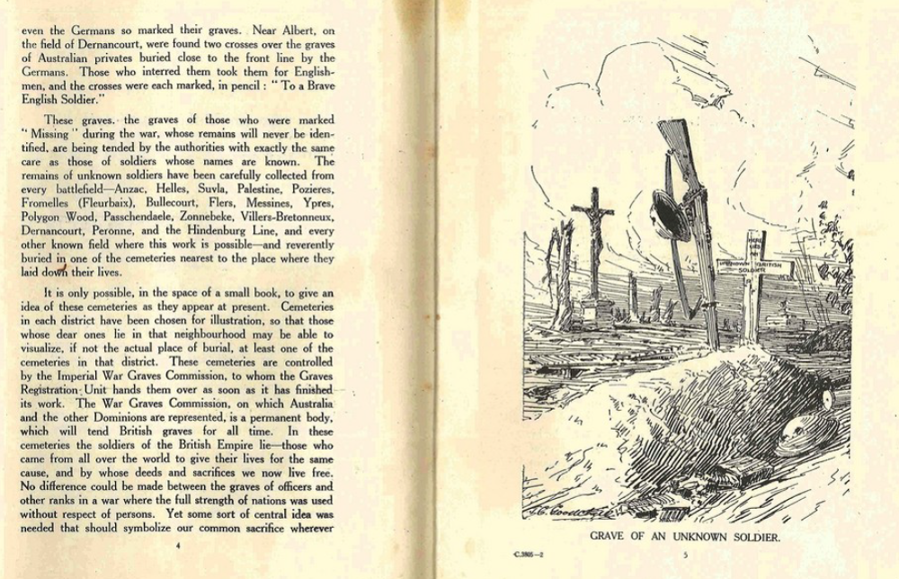
‘If any resting places under heaven are made beautiful by men's hands, these will be, upon which the whole affection of the Empire will lavish its care. Indeed, some of the cemeteries and memorials lie amongst the most beautiful scenes upon the earth.’

Slide 11
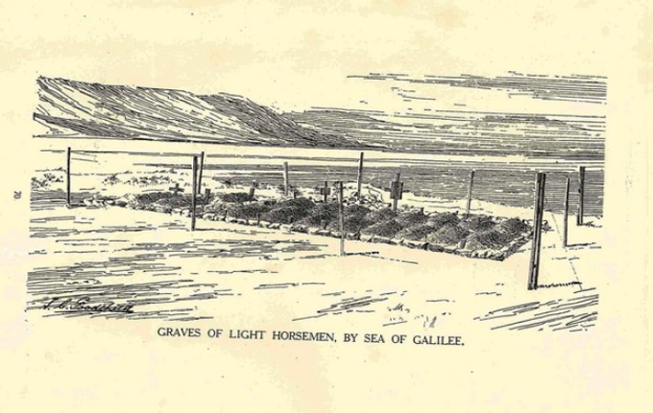
‘In these cemeteries the soldiers of the British empire lie –
those who came from all over the world to give their lives for the same cause and by whose deeds and sacrifices we now live free.’

Slide 12
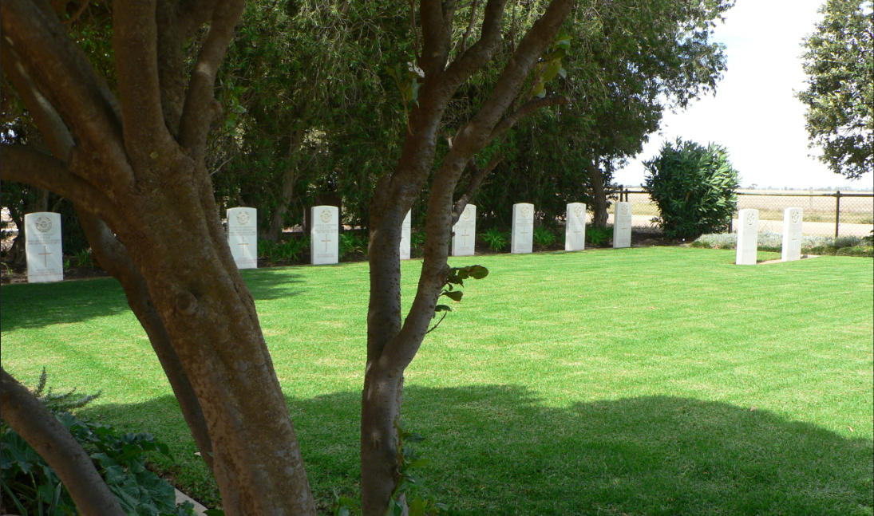
Papua New Guinea – Bomana War Cemetery
Mallala War Cemetery

Slide 13
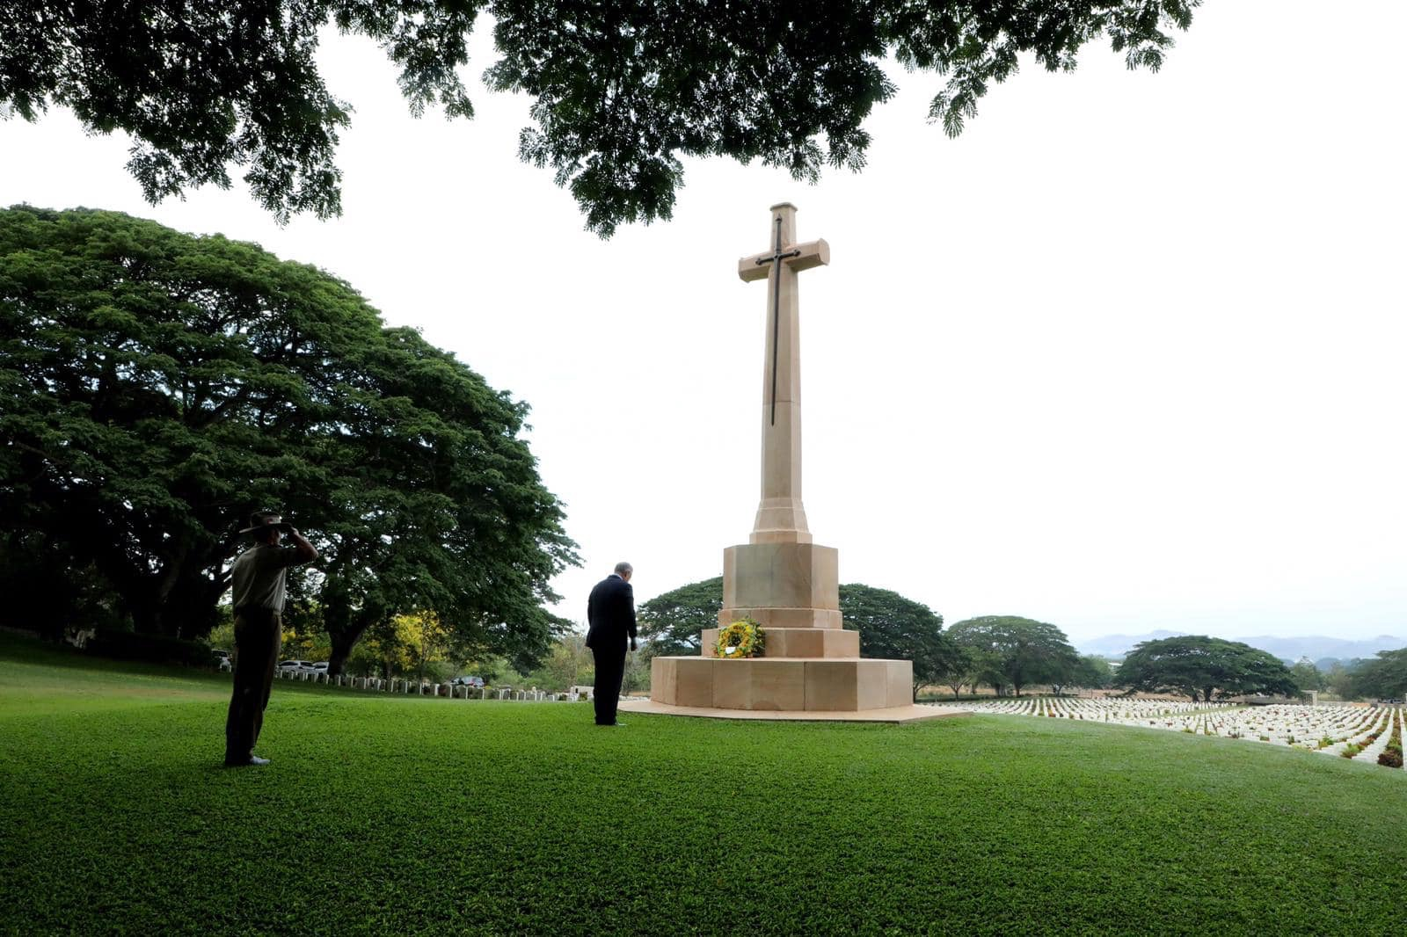

Bomana War Cemetery
Papua New Guinea

Slide 14
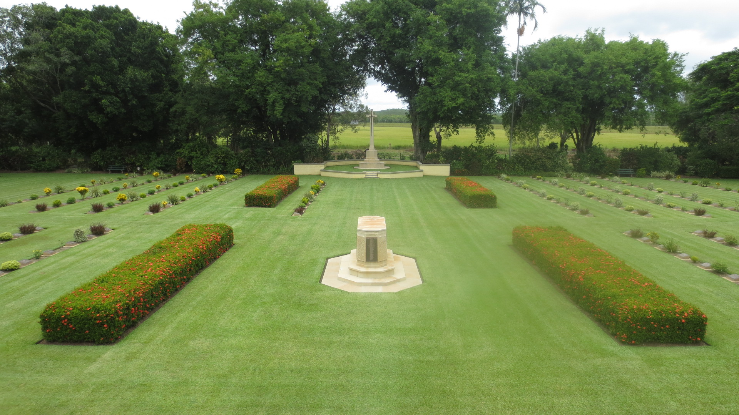

Adelaide River Cemetery, Northern Territory

Slide 15
So, that was then?
What about now?

Slide 16
OAWG = CWGC
In Australia, Papua New Guinea and the Solomon Islands.

Slide 17
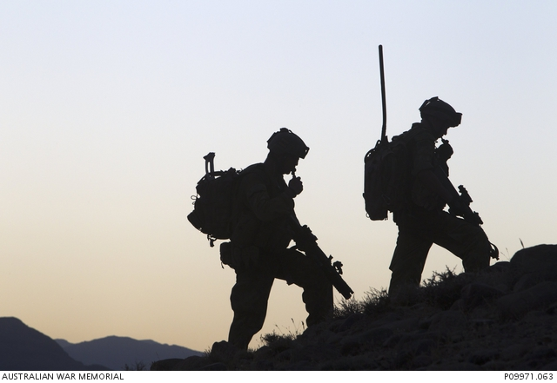

Slide 18
To be eligible for official commemoration, veterans will have met the following criteria:
Post War Commemorations are mostly located in general and civil cemeteries and crematoriums
A veteran of a war or a conflict who is:
a Victoria Cross recipient;
in receipt of a Totally & Permanently Incapacitated pension (TPI) at the time of death and where the veteran has seen service in a war or conflict;
in receipt of an Extreme Disablement Adjustment (EDA) and where the veteran has seen service in a war or conflict;
in receipt of a temporary Special Rate Pension (TSR) or Intermediate Rate Pension (INT) and where the veteran has seen service in a war or conflict;
a multiple amputee on Section 27.1 maximum pension rate;
an ex-prisoner of war;
Or whose death has subsequently been accepted as being due to war service.

Slide 19
What forms do Official Commemorations take?
A memorial in a crematorium (niche or garden ashes placement)
A commemoration in a lawn or general cemetery
3. Memorial in an Australian Government managed Garden of Remembrance

Slide 20
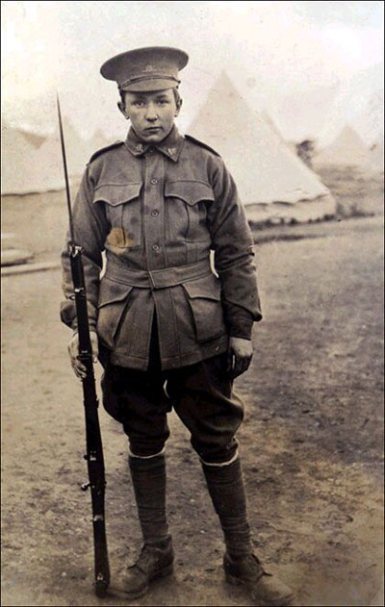
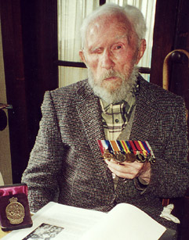
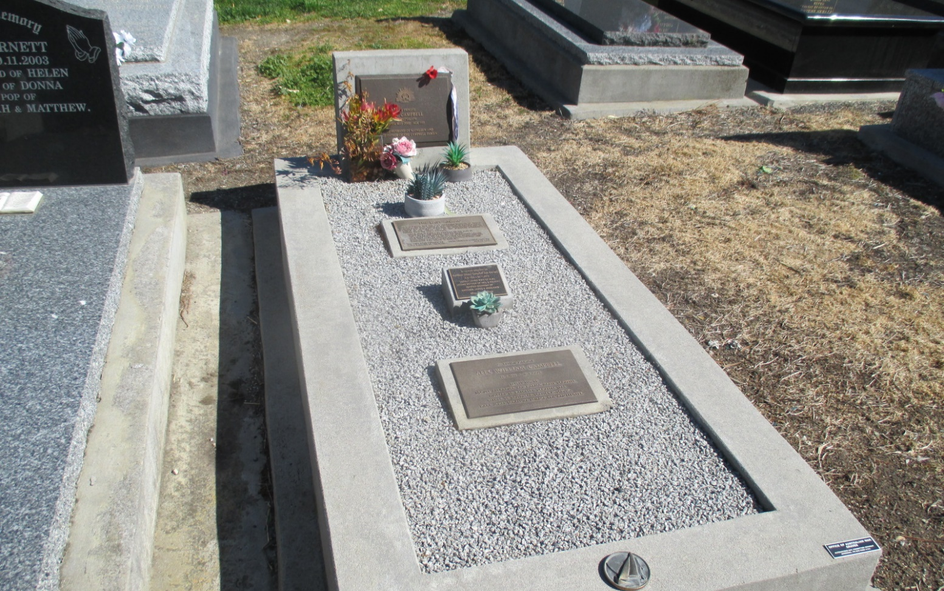

Slide 21
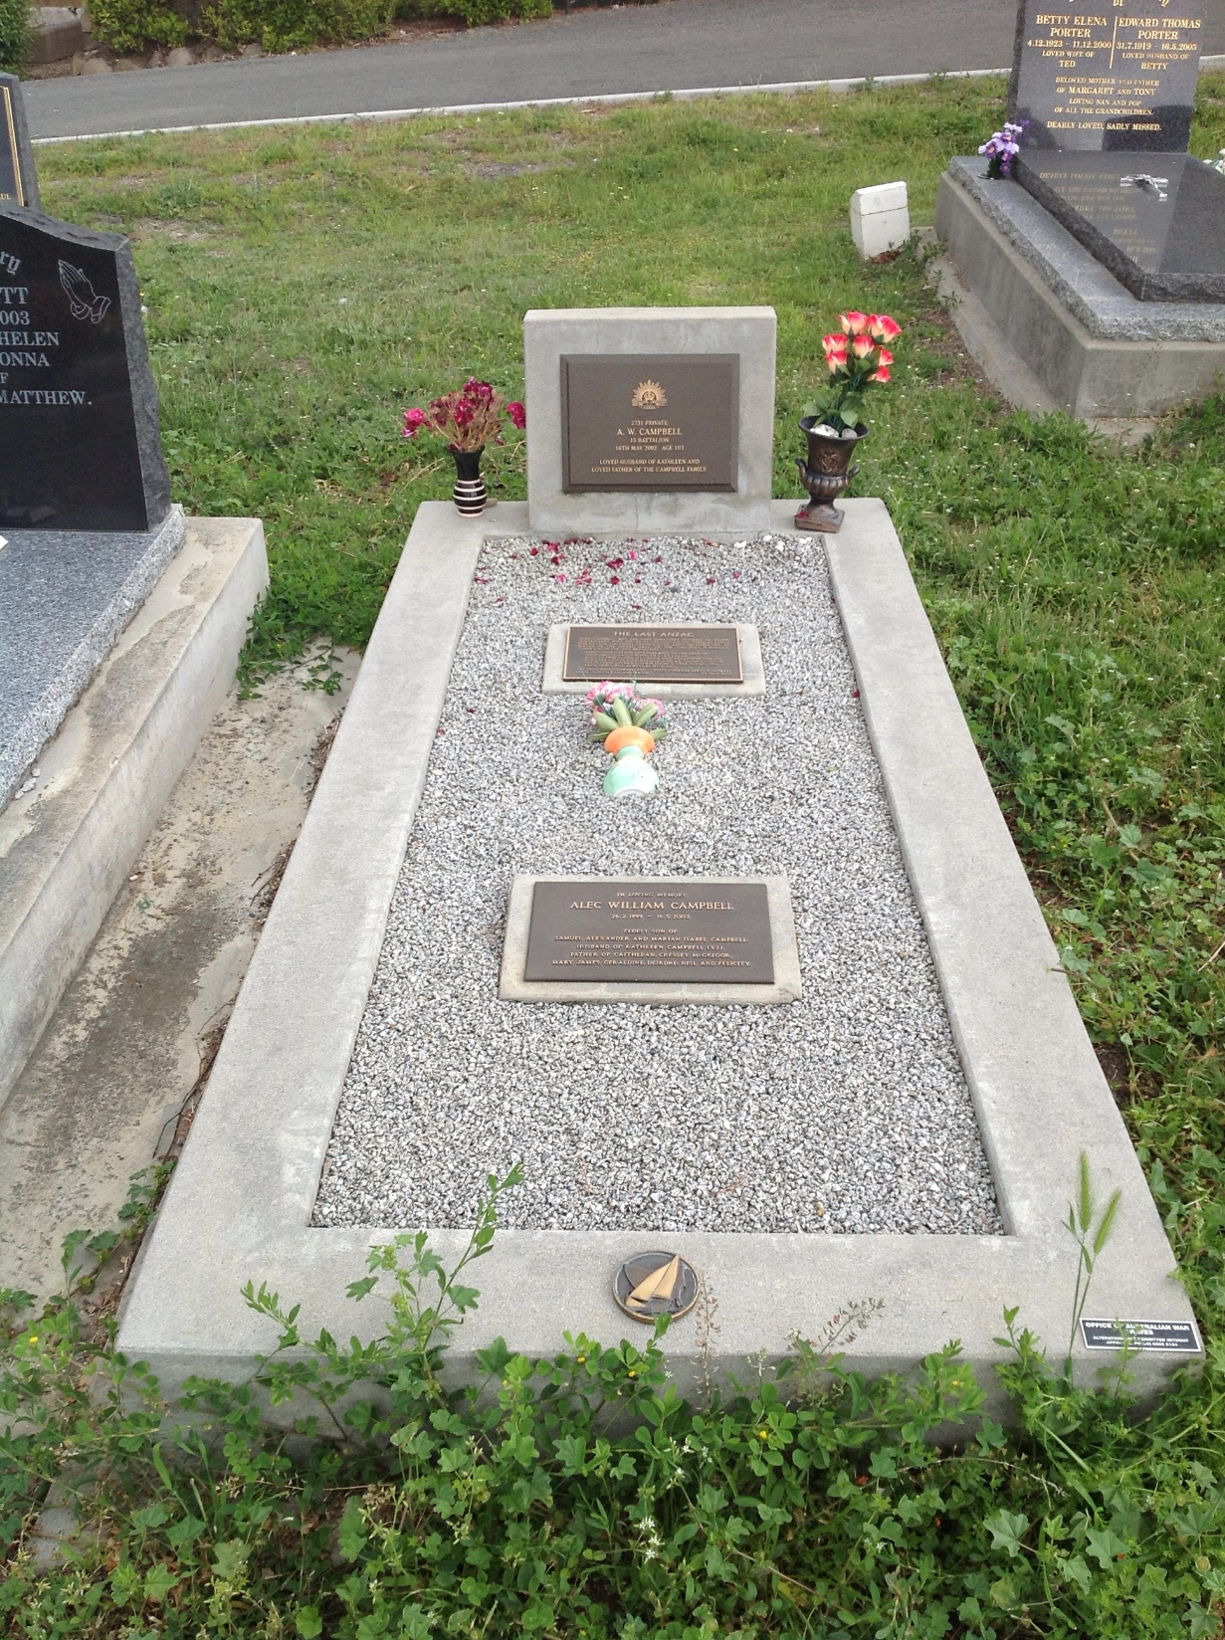
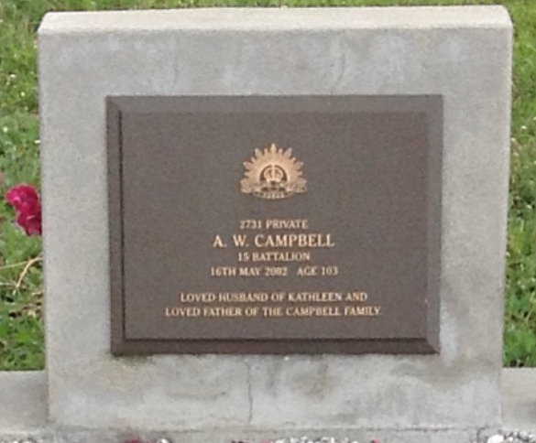
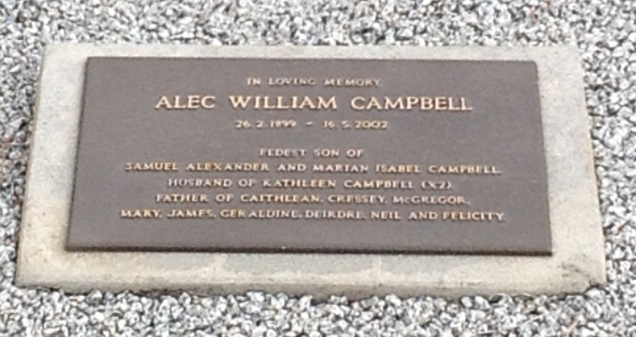
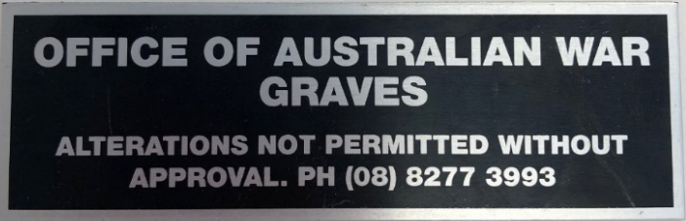
Official Plaque
- Rendered concrete
Specific placement of service details
Optional religious emblem on the left of the plaque
80 characters for a personal inscription
Private plaque placed on the middle or towards the foot of the grave

Slide 22
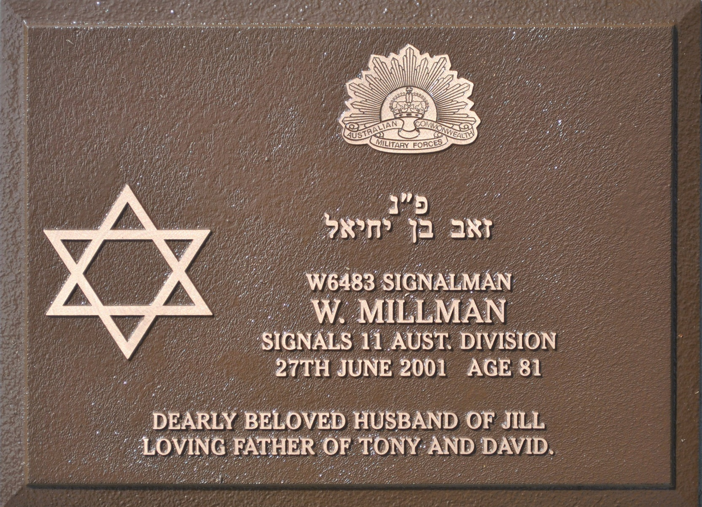
In order to ensure that all veterans are commemorated equally and uniformly, all memorials provided by the OAWG:
Are uniform in design for each type of memorial and to the area of the cemetery where the memorial is to be placed – so we need your plaque dimensions
Remain the property of the OAWG
May not be altered or amended in any way
Whatever option is chosen by a family or responsible person, the commemoration is maintained in perpetuity by OAWG and remains an asset of the Commonwealth.
Papua New Guinea – Bomana War Cemetery
Official plaques allow for the recognition of religion

Slide 23
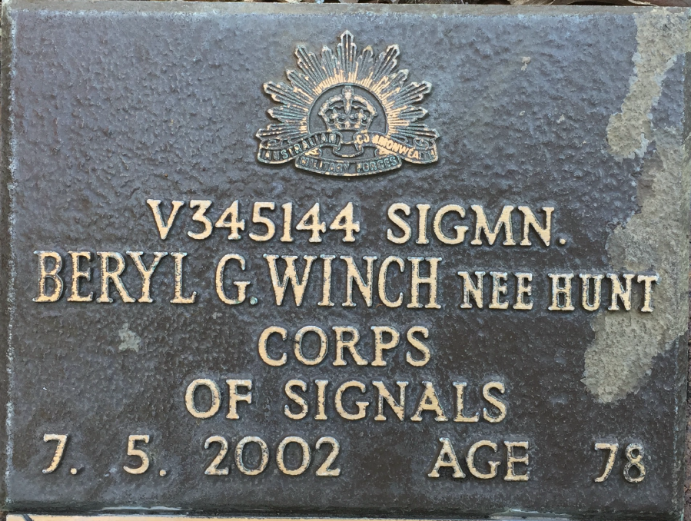
All memorials provided by the OAWG for cremation purposes are uniform in design for each type of memorial.
The OAWG will arrange for the placement of the veteran’s ashes in a single wall niche, sealed with the official bronze plaque, or in a garden bed.
Cremation plaques are not inscribed with a personal message or religious emblem.
Again we need the correct dimensions from you to manufacture the right plaque!
Please note that if ashes have been scattered or are to be retained by the family, a plaque in an OAWG Garden of Remembrance is the only form commemoration available.
OAWG does not inter ashes in our Gardens.

Slide 24
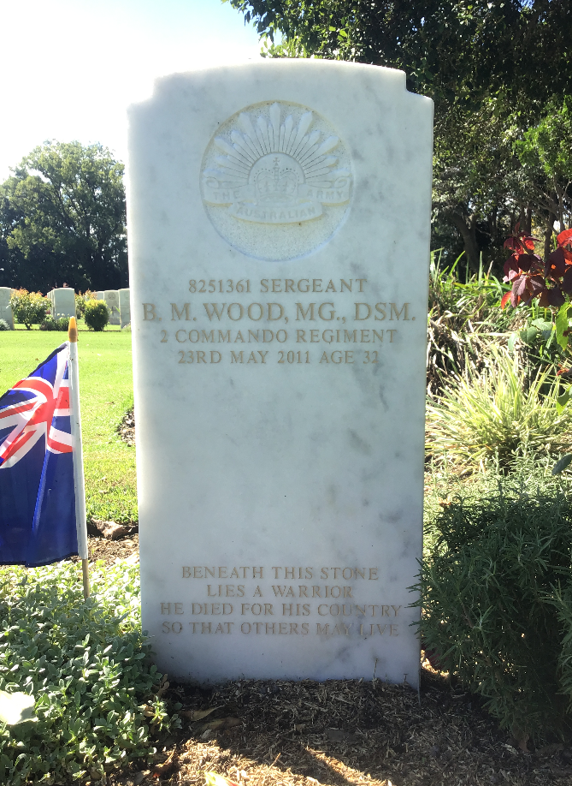
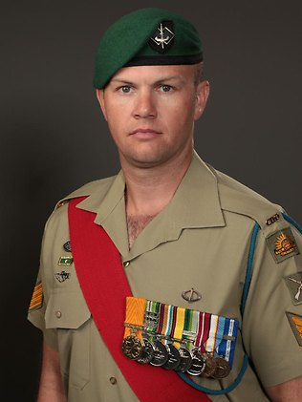
What about contemporary veterans?

Slide 25
An eligible veteran can only have one official commemoration

Slide 26
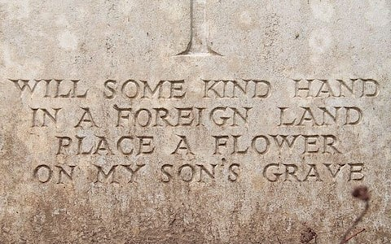
The Defence Act allows that the Director of War Graves, or an officer of the Defence Force in charge of a unit specifically raised for the purpose of the registration of, or inquiries concerning, the graves of deceased members of the Defence Force to
‘…enter a cemetery and inspect, maintain or execute any work in connection with the grave of a person who has died while on service as a member of the Defence Force or as a result of service as a member of the Defence Force or authorize any person or persons to enter a cemetery and inspect, maintain or execute any work in connection with such a grave.’

Slide 27
What about veterans and ex-service men and women who are not eligible for commemoration?
Get permission to use a service badge on a private grave!
You can generate a permission letter authorising the use of a service badge/insignia for veterans of the Second World War, Korean War and Vietnam War can be downloaded from websites:
Second World War: www.ww2roll.gov.au
The Korean War: www.koreanroll.gov.au
The Vietnam War: www.vietnamroll.gov.au
Requests for permission for use of the service badge for veterans who served in conflicts other than those listed above, should be directed to wargraves@dva.gov.au.
All costs and arrangements associated with the private plaque/memorials are the responsibility of the next-of-kin or executor and these commemorations are not maintained by OAWG because they are not official commemorations.

Slide 28
Can a second burial take place with an official commemoration?
The grave of a veteran that is officially commemorated in a general cemetery may be re-opened for further burials — for example a widow/widower or other family member.
Where a full grave monument has been provided, the OAWG will restore the grave to its original condition and the family may then place a plaque for the additional burial on the infill area, in the centre or towards the foot of the grave.
It is prudent to note that the cemetery is responsible for the restoration of graves in lawn areas. An additional plaque may be placed if the lawn cemetery authorities permit.
The veteran's plaque cannot be moved or changed in any way. Families are advised to contact the OAWG to discuss their options with regards to changes.

Slide 29
The plaque or grave provided under the program of official commemoration is paid for and therefore owned and cared for
by the Commonwealth.
DID
YOU KNOW
If there is a need to replace or repair a commemoration OAWG will arrange for the work to be carried out.
Our plaques and headstones are an asset.
We know where every one of the more than 339,465 commemorations are located and work to inspect each on an annual basis.

Slide 30
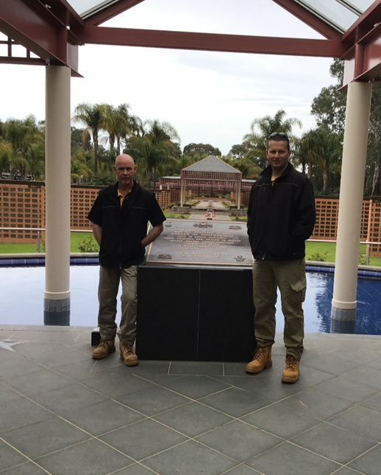
We can’t do what we do without you!
Let us know if you are doing work in areas of cemeteries where we have commemorations. If we know we can tell families when they ask us!
Thank you for the welcome you give us when we are working in your spaces!
Don't assume! Give us a ring and lets work together to function on facts.
Talk to us while we are here!
We are happy to answer any questions you have. My colleagues Martin, Ally, John and Danni are out amongst you today!

Slide 31
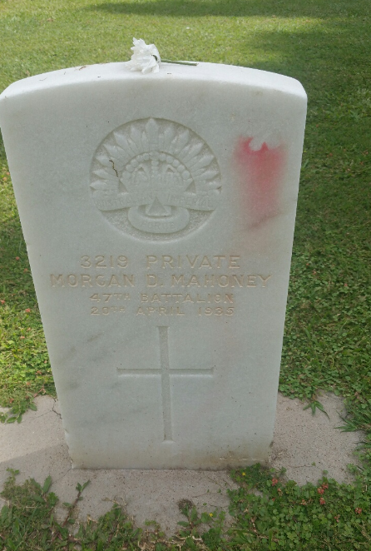
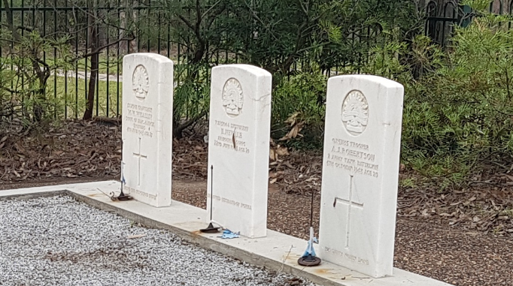
Demonstrations of Remembrance

Slide 32
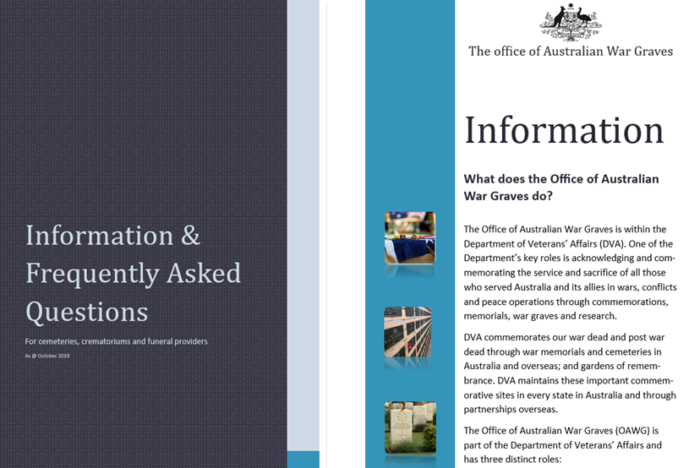
I know you have more questions…
So we’ve put together some helpful info & FAQs for you all!

Slide 33
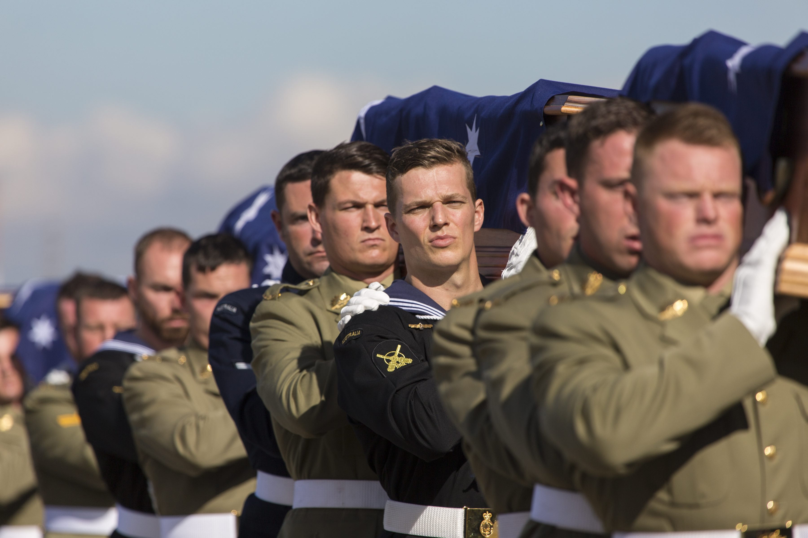

Slide 34
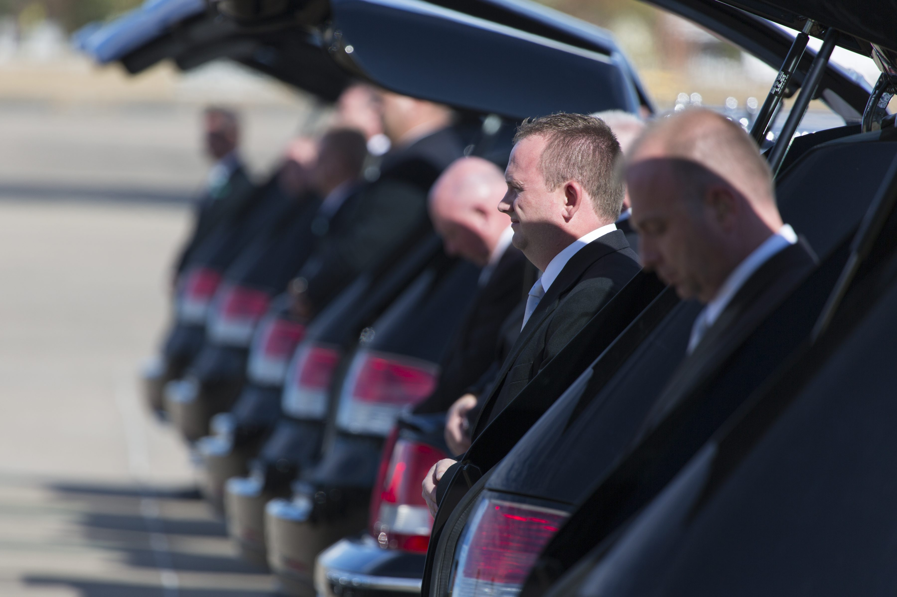

Slide 35
Thank you
For the work you do identifying veterans and passing on our contact details to them; and
for the contact you make when you are not sure and the respect you pay to those who have served their nation and are at rest in your cemeteries and crematoria.
Your care means a great deal to the families of those men and women.

Slide 36

Questions

